Slide 1


SDLC – Release and Maintenance
I choose the coffee theme the most because I write these Powerpoints at 4 in the morning

Slide 2
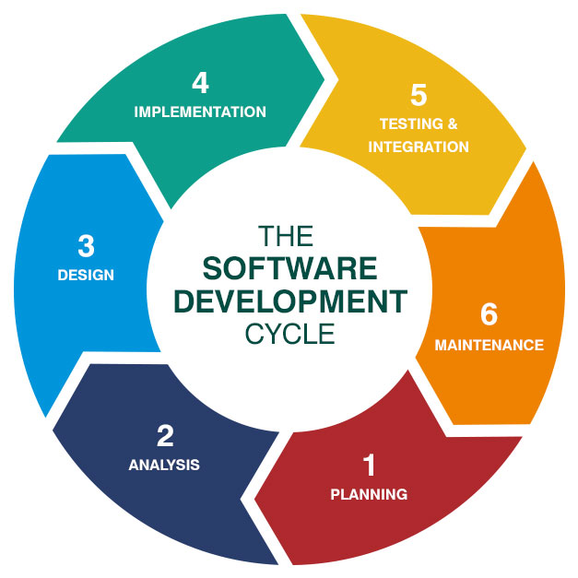
SDLC Recap
Planning
Analysis
Design
Implementation
Testing & Integration
Release and Maintenance

Slide 3
Planning
Research and Familiarization
Initial client request (“Project Brief” or “Initial Proposal”)
Viability
Can/should we do it?
Feasibility
Technical Feasibility study
Economic Feasibility study

Slide 4
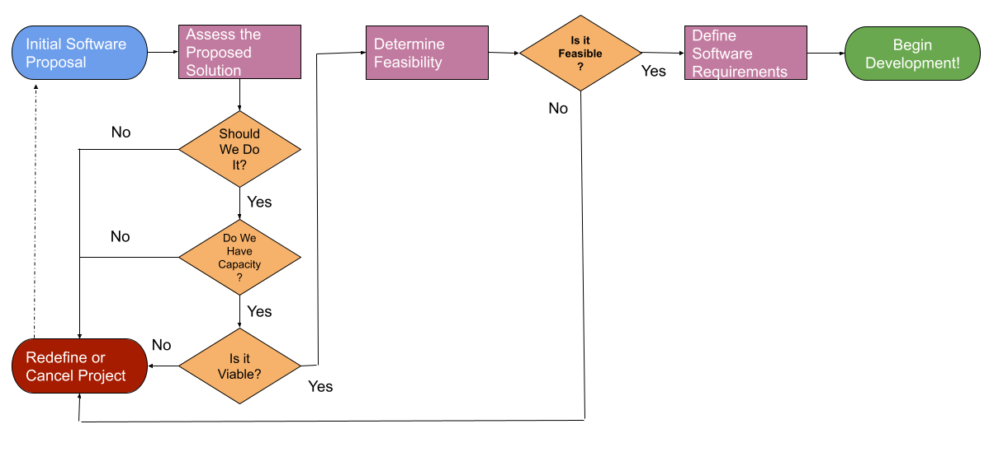
Planning

Slide 5
Output will be the Software Requirements Specification (SRS)
Analysis
Define requirements
Business Requirements
Product Design
Epics, stories
User Acceptance Criteria
Functional and Non-functional requirements
KPIs
Initial Pointing
Performance metrics
Create Estimated Schedule
# Sprints based on point estimate
Milestones / Releases
Create Estimated Budget
Allocate resources
People
Money
Other Resources

Slide 6
Design
Technical Design is fleshed out
Potentially multiple different designs could be created to achieve user stories
Designs are documented in a Software Design Specification (SDS)
Purpose, Scope, Objectives (Epics)
User / Hardware / Software interfaces (sketches, wireframes, descriptions)
Logic / Functionality / Design Considerations (flowcharts, diagrams, pseudocode, User Stories)
Technical Details
Milestones, Constraints, Assumptions/Dependencies
The DDS is then used to break down User Stories into technical tasks
Still high level
May create further stories as functionality is recognized and required
Design must be OK’d by stakeholders before continuing

Slide 7
Implementation
Before Each Sprint
Tickets are triaged
Technical tasks fleshed out based on SDS and User Acceptance Criteria
User Acceptance Test Cases are written based on User Acceptance Criteria
Tickets added to upcoming sprints based on logical order / point values

Slide 8
Implementation and Testing
During Sprint
Tickets are claimed/assigned
Tickets are developed
Code written / UI made
Unit Tests created/updated
Unit Testing / Integration Testing
Tickets are tested
Regression Testing
User Acceptance testing

Slide 9
Testing and Integration
End of Sprint
New features/functionality demonstrated to user
User accepts, dismisses, or sends back work
Preparation/Integration of features into production environment
Team Retrospective
Begin triage/assignment of next sprints’ tickets

Slide 10
Deployment and Maintenance
Features released to Production Environment
Communications to customers
Rollback plan
Training
Deployment
Monitoring
Continued Maintenance and Support
Adding bug fix tickets into backlog to be worked into each sprint or addressed immediately
System Support/User Support

